Slide 1
KHOA CÔNG NGHỆ THÔNG TIN
BỘ MÔN AN TOÀN THÔNG TIN
BÀI GIẢNG
ỨNG DỤNG MẬT MÃ TRONG AN NINH MẠNG
Giáo viên: 4/ Nguyễn Hữu Nội
Đơn vị: Bộ môn ATTT, Khoa CNTT
Liên hệ: Email - huunoidq@gmail.com
SĐT: 0962631881

Slide 2
CRYPTOGRAPHY
Security at the Application Layer: PGP and S/MME
BỘ MÔN ATTT – KHOA CNTT. Contact: huunoidq@gmail.com

Slide 3
CRYPTOGRAPHY
Objectives
To explain the general structure of an e-mail application program
To discuss how PGP can provide security services for e-mail
To discuss how S/MIME can provide security services for e-mail
To define trust mechanism in both PGP and S/MIME
To show the structure of messages exchanged in PGP and S/MIME
BỘ MÔN ATTT – KHOA CNTT. Contact: huunoidq@gmail.com

Slide 4
CRYPTOGRAPHY
16-1 E-MAIL
Let us first discuss the electronic mail (e-mail) system in general.
Topics discussed in this section:
16.1.1 E-mail Architecture
16.1.2 E-mail Security
BỘ MÔN ATTT – KHOA CNTT. Contact: huunoidq@gmail.com

Slide 5
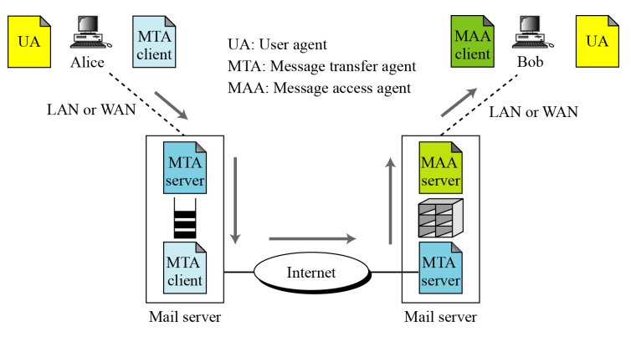
CRYPTOGRAPHY
16.1.1 E-mail Architecture
Figure 16.1 E-mail architecture
BỘ MÔN ATTT – KHOA CNTT. Contact: huunoidq@gmail.com

Slide 6
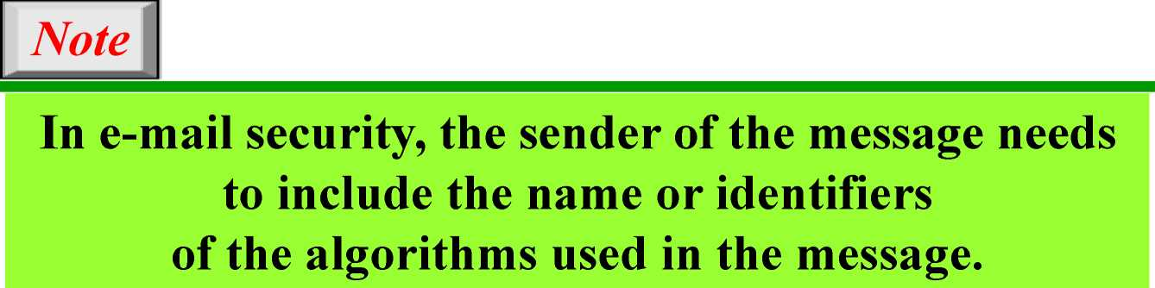
CRYPTOGRAPHY
16.1.2 E-mail Security
Cryptographic Algorithms
Certificates
It is obvious that some public-key algorithms must be used for e-mail security.
BỘ MÔN ATTT – KHOA CNTT. Contact: huunoidq@gmail.com

Slide 7
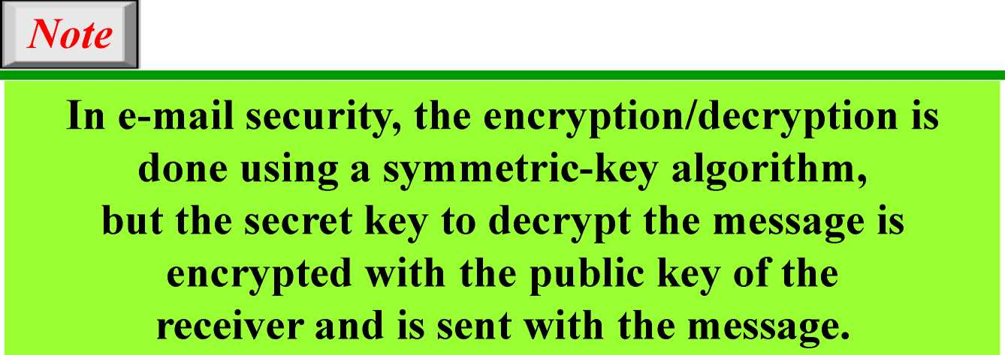
CRYPTOGRAPHY
16.1.2 Continued
Cryptographic Secrets
BỘ MÔN ATTT – KHOA CNTT. Contact: huunoidq@gmail.com

Slide 8
CRYPTOGRAPHY
16-2 PGP
Pretty Good Privacy (PGP) can be used to create a secure e-mail message or to store a file securely for future retrieval.
Topics discussed in this section:
16.2.1 Scenarios
16.2.2 Key Rings
16.2.3 PGP Certificates
16.2.4 Key Revocation
16.2.5 Extracting Information from Rings
16.2.6 PGP Packets
16.2.7 PGP Messages
BỘ MÔN ATTT – KHOA CNTT. Contact: huunoidq@gmail.com

Slide 9
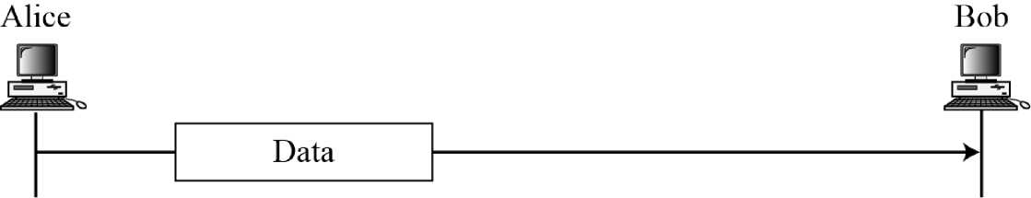
CRYPTOGRAPHY
16.2.1 Scenarios
Plaintext
Figure 16.2 A plaintext message
BỘ MÔN ATTT – KHOA CNTT. Contact: huunoidq@gmail.com

Slide 10
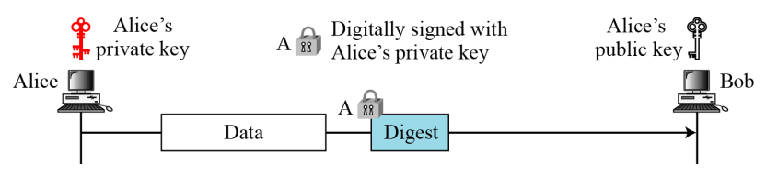
CRYPTOGRAPHY
16.2.1 Continued
Message Integrity
Figure 16.3 An authenticaed message
BỘ MÔN ATTT – KHOA CNTT. Contact: huunoidq@gmail.com

Slide 11
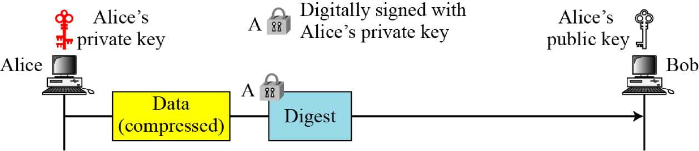
CRYPTOGRAPHY
16.2.1 Continued
Compression
Figure 16.4 A compressed message
BỘ MÔN ATTT – KHOA CNTT. Contact: huunoidq@gmail.com

Slide 12
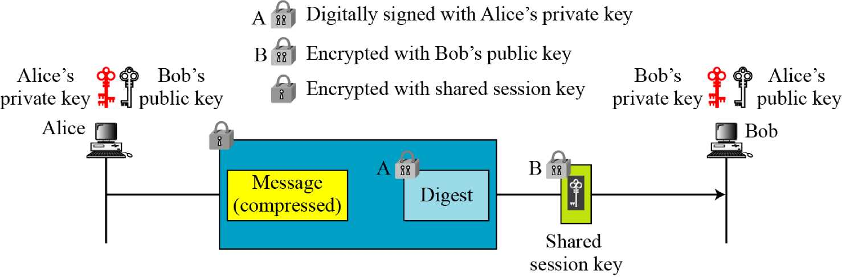
CRYPTOGRAPHY
16.2.1 Continued
Confidentiality with One-Time Session Key
Figure 16.5 A confidential message
BỘ MÔN ATTT – KHOA CNTT. Contact: huunoidq@gmail.com

Slide 13
CRYPTOGRAPHY
16.2.1 Continued
Code Conversion
Another service provided by PGP is code conversion. PGP uses Radix-64 conversion.
Segmentation
PGP allows segmentation of the message.
BỘ MÔN ATTT – KHOA CNTT. Contact: huunoidq@gmail.com

Slide 14
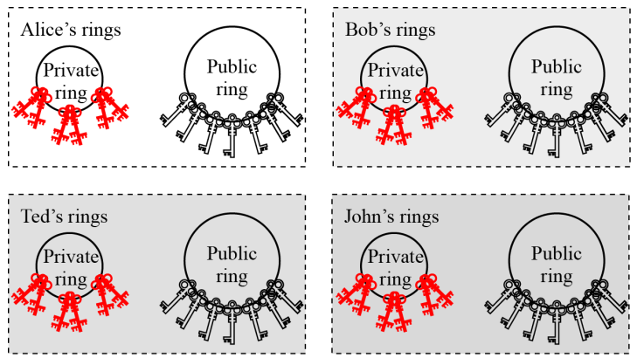
CRYPTOGRAPHY
16.2.2 Key Rings
Figure 16.6 Key rings in PGP
BỘ MÔN ATTT – KHOA CNTT. Contact: huunoidq@gmail.com

Slide 15
CRYPTOGRAPHY
16.2.2 Continued
Table 16.1 Public-key algorithms
ID | Description
1 | RSA (encryption or signing)
2 | RSA (for encryption only)
3 | RSA (for signing only)
16 | ElGamal (encryption only)
17 | DSS
18 | Reserved for elliptic curve
19 | Reserved for ECDSA
20 | ElGamal (for encryption or signing)
21 | Reserved for Diffie-Hellman
100-110 | Private algorithms
BỘ MÔN ATTT – KHOA CNTT. Contact: huunoidq@gmail.com

Slide 16
CRYPTOGRAPHY
16.2.2 Continued
Table 16.2 Symmetric-key algorithms
ID | Description
0 | No Encryption
1 | IDEA
2 | Triple DES
3 | CAST-128
4 | Blowfish
5 | SAFER-SK128
6 | Reserved for DES/SK
7 | Reserved for AES-128
8 | Reserved for AES-192
9 | Reserved for AES-256
100-110 | Private algorithms
BỘ MÔN ATTT – KHOA CNTT. Contact: huunoidq@gmail.com

Slide 17
CRYPTOGRAPHY
16.2.2 Continued
Table 16.3 Hash Algorithms
ID | Description
1 | MD5
2 | SHA-1
3 | RIPE-MD/160
4 | Reserved for double-width SHA
5 | MD2
6 | TIGER/192
7 | Reserved for HAVAL
100-110 | Private algorithms
BỘ MÔN ATTT – KHOA CNTT. Contact: huunoidq@gmail.com

Slide 18
CRYPTOGRAPHY
16.2.2 Continued
Table 16.4 Compression methods
ID | Description
0 | Uncompressed
1 | ZIP
2 | ZLIP
100-110 | Private methods
BỘ MÔN ATTT – KHOA CNTT. Contact: huunoidq@gmail.com

Slide 19
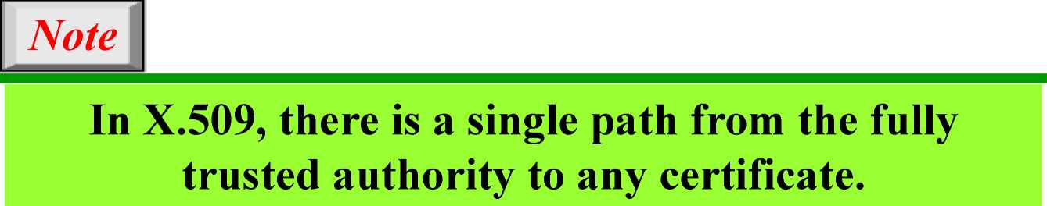
CRYPTOGRAPHY
16.2.3 PGP Certificates
X.509 Certificates
Protocols that use X.509 certificates depend on the hierarchical structure of the trust.
BỘ MÔN ATTT – KHOA CNTT. Contact: huunoidq@gmail.com

Slide 20
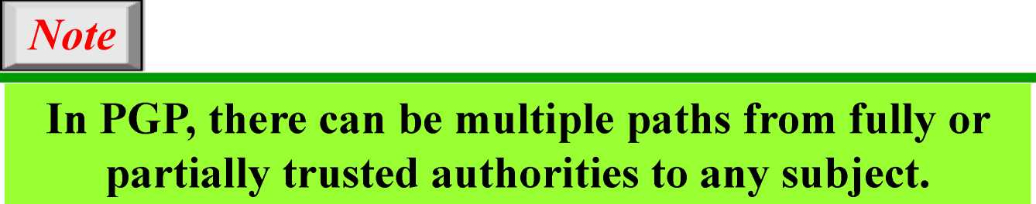
CRYPTOGRAPHY
16.2.3 Continued
PGP Certificates
In PGP, there is no need for CAs; anyone in the ring can sign a certificate for anyone else in the ring.
Trusts and Legitimacy
The entire operation of PGP is based on introducer trust, the certificate trust, and the legitimacy of the public keys.
BỘ MÔN ATTT – KHOA CNTT. Contact: huunoidq@gmail.com

Slide 21
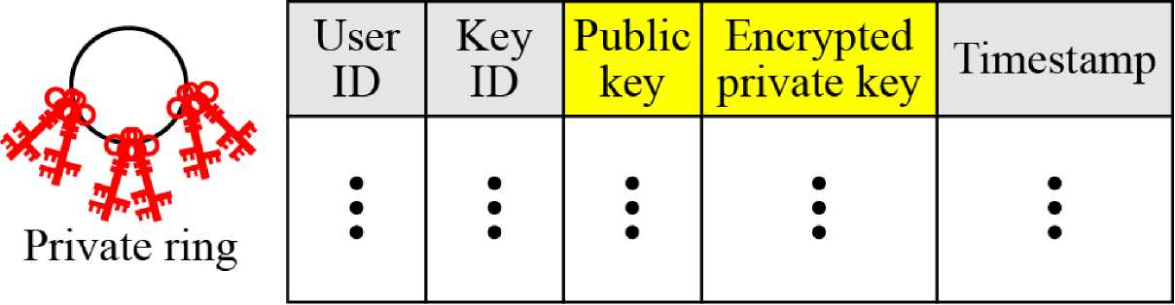
CRYPTOGRAPHY
16.2.3 Continued
Figure 16.7 Format of priv ate key ring table
BỘ MÔN ATTT – KHOA CNTT. Contact: huunoidq@gmail.com

Slide 22
CRYPTOGRAPHY
16.2.3 Continued
Example 16.1
Let us show a private key ring table for Alice. We assume that Alice has only two user IDs, alice@some.com and alice@anet.net. We also assume that Alice has two sets of private/public keys, one for each user ID.
Table 16.5 Private key ring table for Example 1
User ID | Key ID | Public Key | Encrypted Private Key | Timestamp
alice@anet.net | AB13...45 | AB13...45...59 | 324S2398...23 | 031505-16:23
alice@some.com | FA23...12 | FA23... 12...22 | 564A4923...23 | 031504-08:11
BỘ MÔN ATTT – KHOA CNTT. Contact: huunoidq@gmail.com

Slide 23
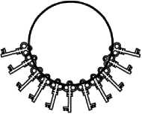
CRYPTOGRAPHY
16.2.3 Continued
Figure 16.8 Format of a public key ring table
User ID | Key ID | Public key | Producer trust | Certificate(s) | Certificate trust(s) | Key Legitimacy | Timestamp
• • • | • • • | • • • | • • • | • • • | • • • | • • • | • • •
Public ring
BỘ MÔN ATTT – KHOA CNTT. Contact: huunoidq@gmail.com

Slide 24
CRYPTOGRAPHY
16.2.3 Continued
Example 16.2
A series of steps will show how a public key ring table is formed for Alice.
Table 16.6 Example 2, starting table
User ID | Key ID | Public key | Prod. trust | Certificate | Cert. trust | Key legit. | Tiniest amp
Alice... | AB... | AB....... | F |  |  | F
Table 16.7 Example 2, after Bob is added to the table
User ID | Key ID | Public key | Prod. trust | Certificate | Cert. trust | Key legit. | Tiniest amp
Alice... | AB... | AB........ | F |  |  | F
Bob... | 12... | 12........ | F |  |  | F
BỘ MÔN ATTT – KHOA CNTT. Contact: huunoidq@gmail.com

Slide 25
CRYPTOGRAPHY
16.2.3 Continued
Example 16.2
Table 16.8 Example 2, after Ted is added to the table
User ID | Key ID | Public key | Prod. trust | Certificate | Cert. trust | Key legit. | Time¬ stamp
Alice... | AB... | AB........ | F |  |  | F
Bob... | 12... | 12........ | F |  |  | F
Ted... | 48... | 48........ | F | Bob’s | F | F
Table 16.9 Example 2, after Anne is added to the table
User ID | Key ID | Public key | Prod. trust | Certificate | Cert. trust | Key legit. | Time¬ stamp
Alice... | AB... | AB........ | F |  |  | F
Bob... | 12... | 12........ | F |  |  | F
Ted... | 48... | 48........ | F | Bob’s | F | F
Anne... | 71... | 71........ | P | Bob’s | F | F
BỘ MÔN ATTT – KHOA CNTT. Contact: huunoidq@gmail.com

Slide 26
CRYPTOGRAPHY
16.2.3 Continued
Example 16.2
Table 16.10 Example 2, after John is added to the table
User ID | Key ID | Public key | Prod. Trust | Certificate | Cert. trust | Key legit. | Time¬ stamp
Alice... | AB... | AB........ | F |  |  | F
Bob... | 12... | 12........ | F |  |  | F
Ted... | 48... | 48........ | F | Bob’s | F | F
Anne... | 71... | 71........ | P | Bob’s | F | F
John... | 31... | 31........ | N | Anne’s | P | P
BỘ MÔN ATTT – KHOA CNTT. Contact: huunoidq@gmail.com

Slide 27
CRYPTOGRAPHY
16.2.3 Continued
Example 16.2
Table 16.11 Example 2, after one more certificate received for John
User ID | Key ID | Public key | Prod. trust | Certificate | Cert. trust | Key legit. | Time¬ stamp
Alice... | AB... | AB........ | F |  |  | F
Bob... | 12... | 12........ | F |  |  | F
Ted... | 48... | 48........ | F | Bob’s | F | F
Anne... | 71... | 71........ | P | Bob’s | F | F
John... | 31... | 31........ | N | Anne’s | P | F
 |  |  |  | Ted’s | F
BỘ MÔN ATTT – KHOA CNTT. Contact: huunoidq@gmail.com

Slide 28
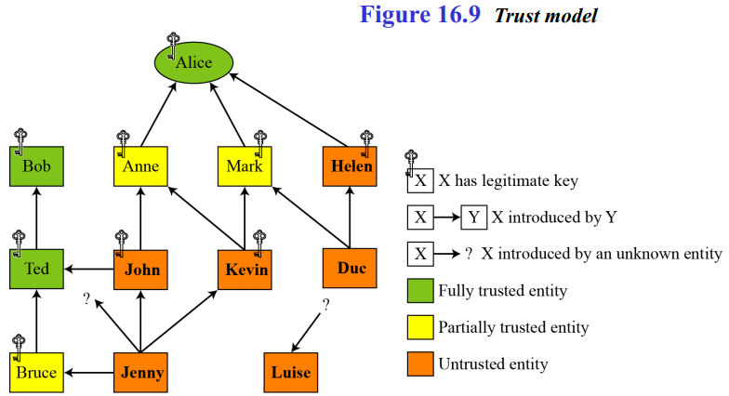
CRYPTOGRAPHY
16.2.3 Continued
Trust Model in PGP
BỘ MÔN ATTT – KHOA CNTT. Contact: huunoidq@gmail.com

Slide 29
CRYPTOGRAPHY
16.2.4 Key Revocation
It may become necessary for an entity to revoke his or her public key from the ring. This may happen if the owner of the key feels that the key is compromised (stolen, for example) or just too old to be safe.
BỘ MÔN ATTT – KHOA CNTT. Contact: huunoidq@gmail.com

Slide 30
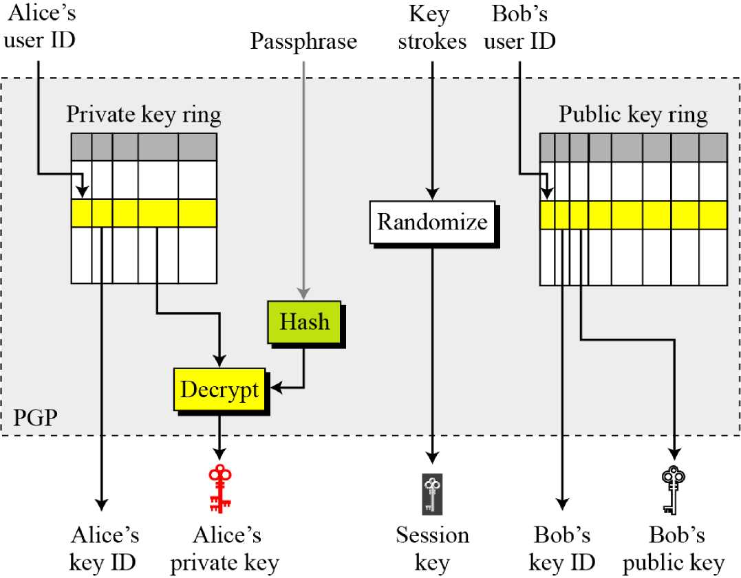
CRYPTOGRAPHY
16.2.5 Extracting Information from Rings
Figure 16.10 Extracting information at the sender site
BỘ MÔN ATTT – KHOA CNTT. Contact: huunoidq@gmail.com

Slide 31
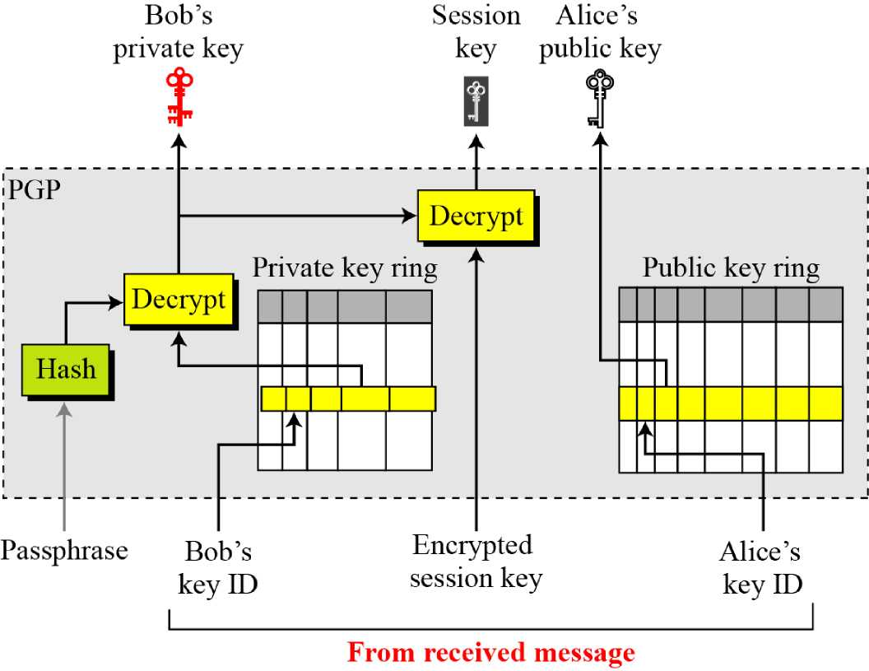
CRYPTOGRAPHY
16.2.5 Continued
Figure 16.11 Extracting info. mation at the receiver site
BỘ MÔN ATTT – KHOA CNTT. Contact: huunoidq@gmail.com

Slide 32
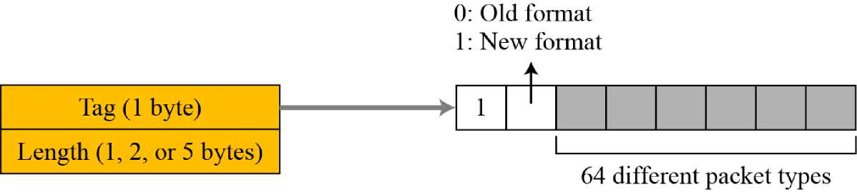
CRYPTOGRAPHY
16.2.6 PGP Packets
Figure 16.12 Format of packet header
BỘ MÔN ATTT – KHOA CNTT. Contact: huunoidq@gmail.com

Slide 33
CRYPTOGRAPHY
16.2.6 Continued
Table 16.12 Some commonly used packet types
Value | Packet type
i | Session key packet encrypted using a public key
2 | Signature packet
5 | Private-key packet
6 | Public-key packet
8 | Compressed data packet
9 | Data packet encrypted with a secret key
11 | Literal data packet
13 | User ID packet
BỘ MÔN ATTT – KHOA CNTT. Contact: huunoidq@gmail.com

Slide 34
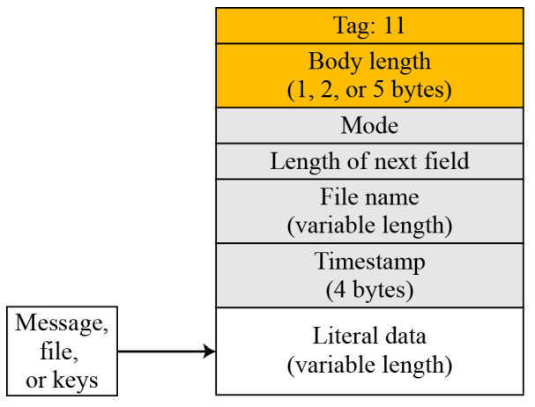
CRYPTOGRAPHY
16.2.6 Continued
Figure 16.13 Literal dat packet
BỘ MÔN ATTT – KHOA CNTT. Contact: huunoidq@gmail.com

Slide 35
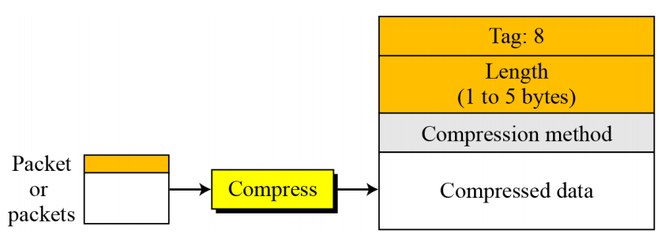
CRYPTOGRAPHY
16.2.6 Continued
Figure 16.14 Compressed data packet
BỘ MÔN ATTT – KHOA CNTT. Contact: huunoidq@gmail.com

Slide 36
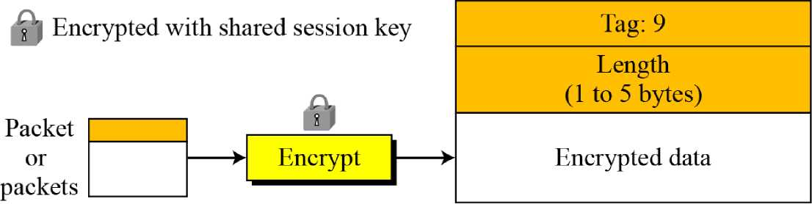
CRYPTOGRAPHY
16.2.6 Continued
Figure 16.15 Encrypted data packet
BỘ MÔN ATTT – KHOA CNTT. Contact: huunoidq@gmail.com

Slide 37
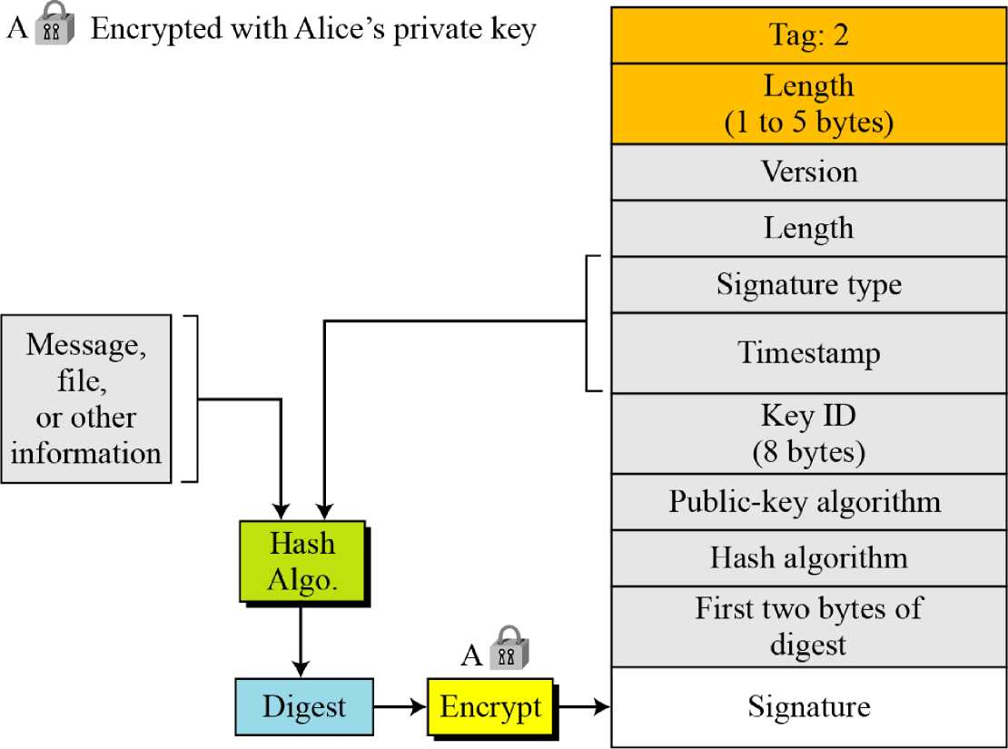
CRYPTOGRAPHY
16.2.6 Continued
Figure 16.16 Signature packet
BỘ MÔN ATTT – KHOA CNTT. Contact: huunoidq@gmail.com

Slide 38
CRYPTOGRAPHY
16.2.6 Continued
Table 16.13 Some signature values
Value | Signature
0x00 | Signature of a binary document (message or file).
0x01 | Signature of a text document (message or file).
0x10 | Generic certificate of a user ID and public-key packet. The signer does not make any particular assertion about the owner of the key.
0x11 | Personal certificate of a user ID and public-key packet. No verification is done on the owner of the key.
0x12 | Casual certificate of a User ID and public-key packet. Some casual verification done on the owner of the key.
0x13 | Positive certificate of a user ID and public-key packet. Substantial verification done.
0x30 | Certificate revocation signature. This removes an earlier certificate (QvlO through 0x13).
BỘ MÔN ATTT – KHOA CNTT. Contact: huunoidq@gmail.com

Slide 39
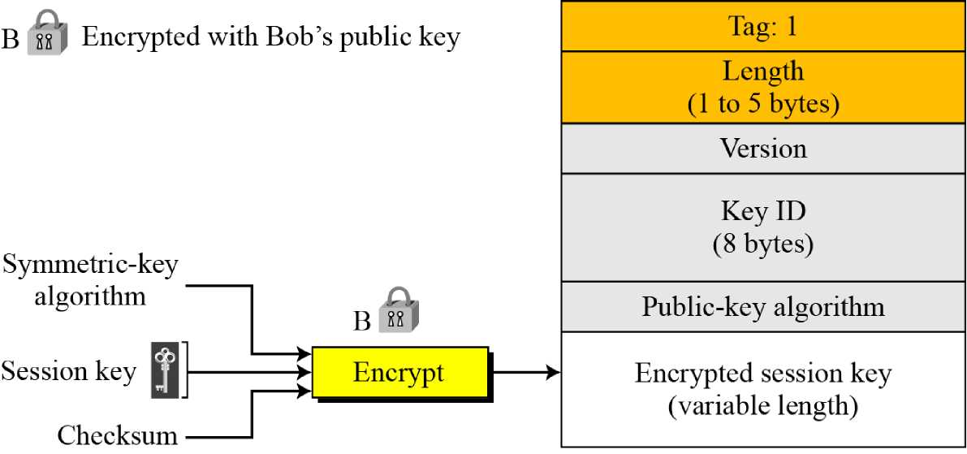
CRYPTOGRAPHY
16.2.6 Continued
Figure 16.17 Session-key packet
BỘ MÔN ATTT – KHOA CNTT. Contact: huunoidq@gmail.com

Slide 40
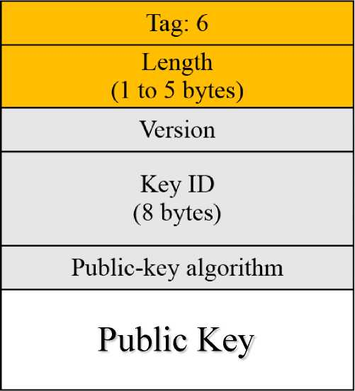
CRYPTOGRAPHY
16.2.6 Continued
Figure 16.18 Public-key packet
BỘ MÔN ATTT – KHOA CNTT. Contact: huunoidq@gmail.com

Slide 41
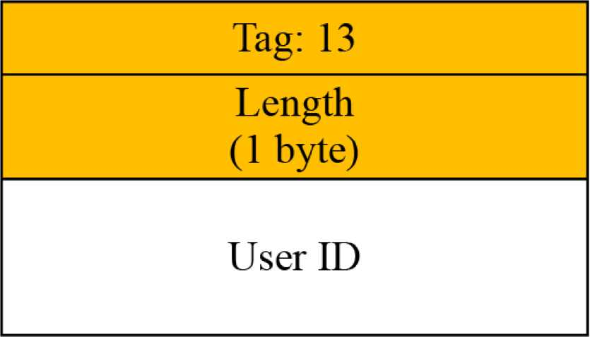
CRYPTOGRAPHY
16.2.6 Continued
Figure 16.19 User ID packet
BỘ MÔN ATTT – KHOA CNTT. Contact: huunoidq@gmail.com

Slide 42
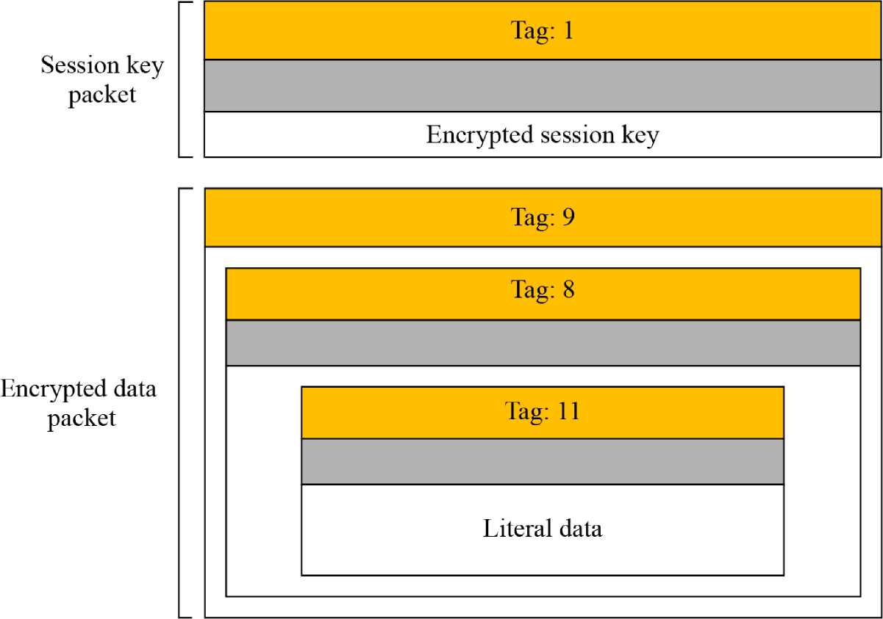
CRYPTOGRAPHY
16.2.7 PGP Messages
Figure 16.20 Encrypted message
BỘ MÔN ATTT – KHOA CNTT. Contact: huunoidq@gmail.com

Slide 43
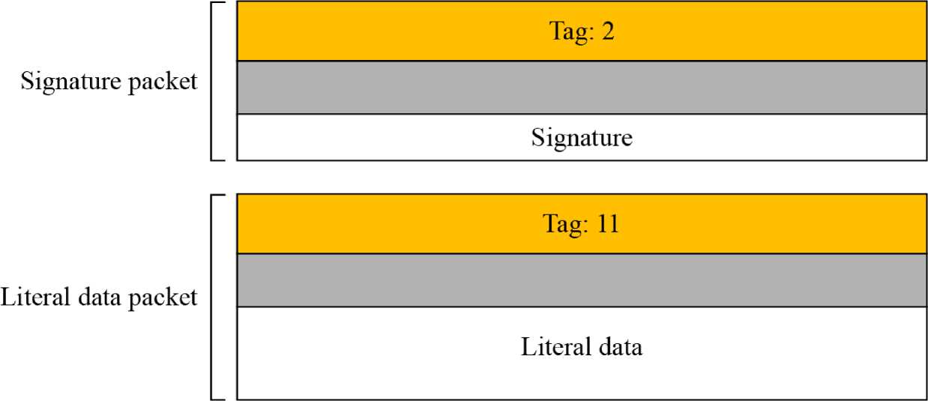
CRYPTOGRAPHY
16.2.7 Continued
Figure 16.21 Signed message
BỘ MÔN ATTT – KHOA CNTT. Contact: huunoidq@gmail.com

Slide 44
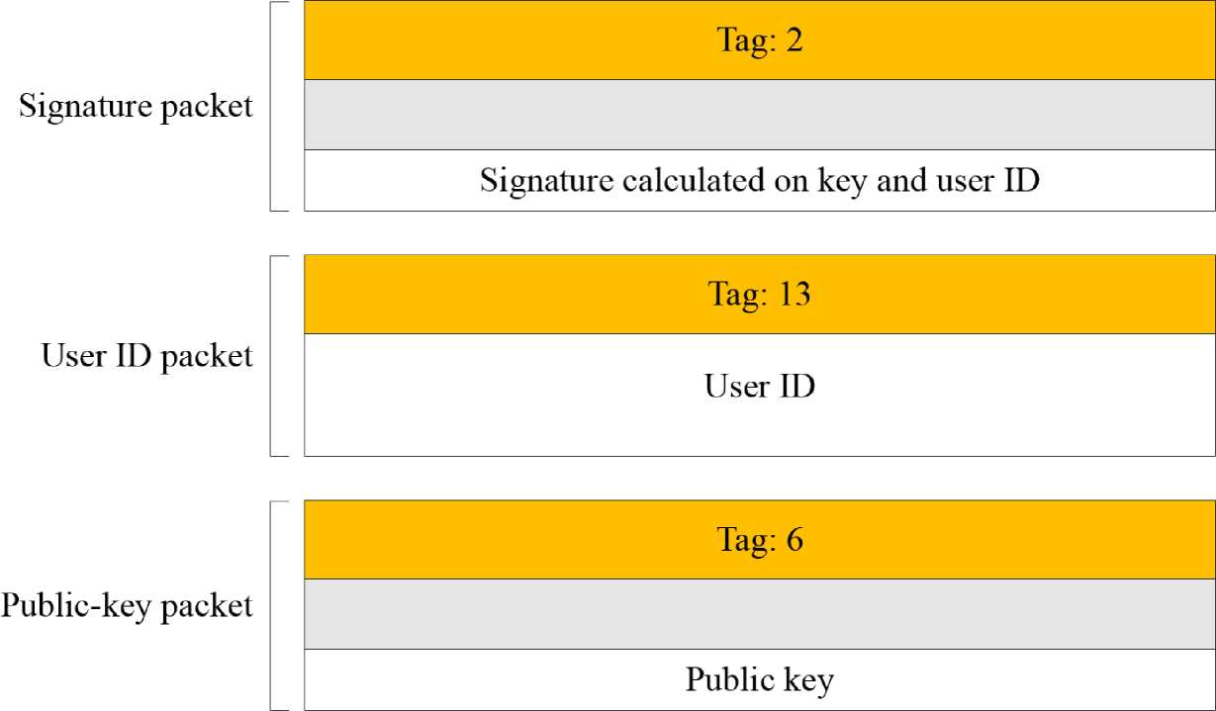
CRYPTOGRAPHY
16.2.7 Continued
Figure 16.22 Certificate message
BỘ MÔN ATTT – KHOA CNTT. Contact: huunoidq@gmail.com

Slide 45
CRYPTOGRAPHY
16-3 S/MIME
Another security service designed for electronic mail is Secure/Multipurpose Internet Mail Extension (S/MIME). The protocol is an enhancement of the Multipurpose Internet Mail Extension (MIME) protocol.
Topics discussed in this section:
16.3.1 MIME
16.3.2 S/MIME
16.3.3 Applications of S/MIME
BỘ MÔN ATTT – KHOA CNTT. Contact: huunoidq@gmail.com

Slide 46
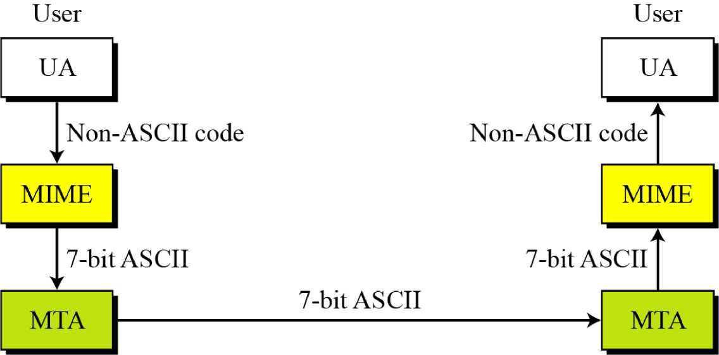
CRYPTOGRAPHY
16.3.1 Continued
Figure 16.23 MIME
BỘ MÔN ATTT – KHOA CNTT. Contact: huunoidq@gmail.com

Slide 47
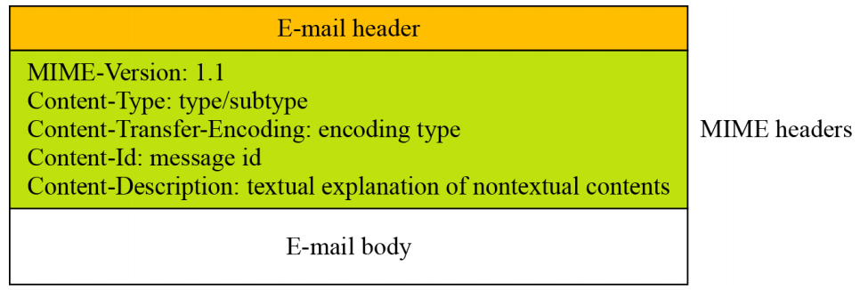
CRYPTOGRAPHY
16.3.1 Continued
Figure 16.24 Teledesic
BỘ MÔN ATTT – KHOA CNTT. Contact: huunoidq@gmail.com

Slide 48
CRYPTOGRAPHY
16.3.1 Continued
MIME- Version
This header defines the version of MIME used. The
current version is 1.1.
MIME-Version: 1.1
Content-Type
The content type and the content subtype are separated by a slash. Depending on the subtype, the header may contain other parameters.
Content-Type: <type / subtype; parameters>
BỘ MÔN ATTT – KHOA CNTT. Contact: huunoidq@gmail.com

Slide 49
CRYPTOGRAPHY
16.3.1 Continued
Table 16.14 Data types and subtypes in MIME
Type | Subtype | Description
 | Plain | Unformatted.
 | HTML | HTML format.
Multipart | Mixed | Body contains ordered parts of different data types.
 | Parallel | Same as above, but no order.
 | Digest | Similar to Mixed, but the default is message/RFC822.
 | Alternative | Parts are different versions of the same message.
Message | RFC822 | Body is an encapsulated message.
 | Partial | Body is a fragment of a bigger message.
 | External-Body | Body is a reference to another message.
Image | JPEG | Image is in JPEG format.
 | GIF | Image is in GIF format.
Video | MPEG | Video is in MPEG format.
Audio | Basic | Single channel encoding of voice at 8 KHz.
Application | PostScript | Adobe PostScript.
 | Octet-stream | General binary data (eight-bit bytes).
BỘ MÔN ATTT – KHOA CNTT. Contact: huunoidq@gmail.com

Slide 50
CRYPTOGRAPHY
16.3.1 Continued
Table 16.15 Content-transfer-encoding
Type | Description
7b it | NVT ASCII characters and short lines.
8bit | Non-ASCII characters and short lines.
Binary | Non-ASCII characters with unlimited-length lines.
Radix-64 | 6-bit blocks of data are encoded into 8-bit ASCII characters using Radix-64 conversion.
Quoted-printable | Non-ASCII characters are encoded as an equal sign followed by an ASCII code.
BỘ MÔN ATTT – KHOA CNTT. Contact: huunoidq@gmail.com

Slide 51
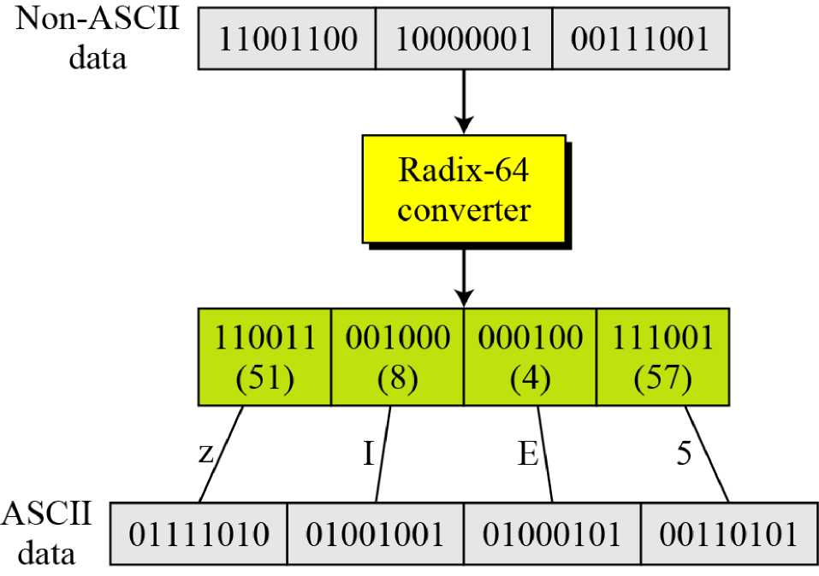
CRYPTOGRAPHY
16.3.1 Continued
Figure 16.25 Radix-64 conversion
BỘ MÔN ATTT – KHOA CNTT. Contact: huunoidq@gmail.com

Slide 52
CRYPTOGRAPHY
16.3.1 Continued
Table 16.16 Radix-64 encoding table
Value | Code | Value | Code | Value | Code | Value | Code | Value | Code | Value | Code
0 | A | 11 | L | 22 | W | 33 | h | 44 | s | 55 | 3
1 | B | 12 | M | 23 | X | 34 | ♦ i | 45 | t | 56 | 4
2 | C | 13 | N | 24 | Y | 35 | • J | 46 | u | 57 | 5
3 | D | 14 | O | 25 | Z | 36 | k | 47 | V | 58 | 6
4 | E | 15 | P | 26 | a | 37 | 1 | 48 | w | 59 | 7
5 | F | 16 | Q | 27 | b | 38 | m | 49 | X | 60 | 8
6 | G | 17 | R | 28 | c | 39 | n | 50 | y | 61 | 9
7 | H | 18 | S | 29 | d | 40 | o | 51 | z | 62 | +
8 | I | 19 | T | 30 | e | 41 | P | 52 | 0 | 63 | /
9 | J | 20 | U | 31 | f | 42 | q | 53 | 1
10 | K | 21 | V | 32 | g | 43 | r | 54 | 2
BỘ MÔN ATTT – KHOA CNTT. Contact: huunoidq@gmail.com

Slide 53
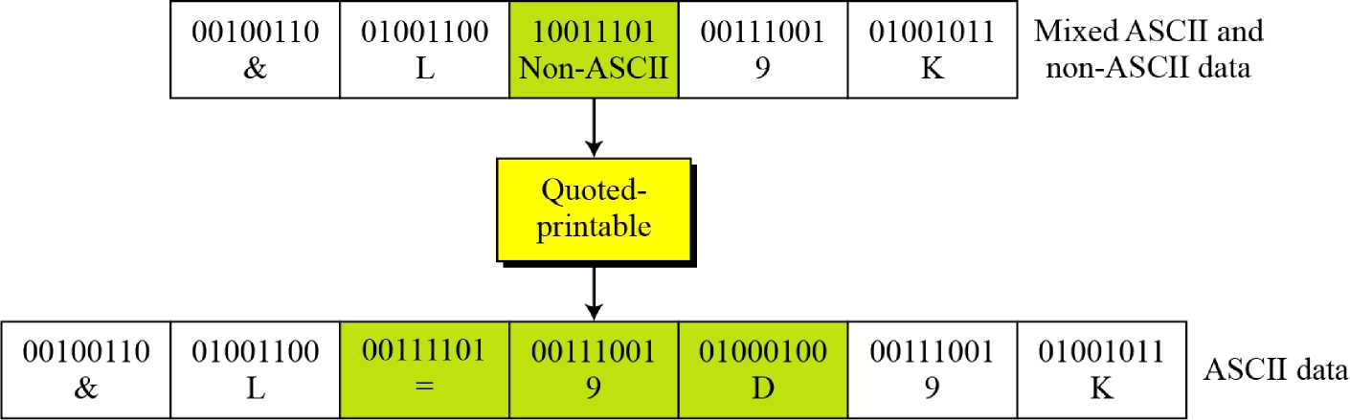
CRYPTOGRAPHY
16.3.1 Continued
Figure 16.26 Quoted-printable
BỘ MÔN ATTT – KHOA CNTT. Contact: huunoidq@gmail.com

Slide 54
CRYPTOGRAPHY
16.3.2 S/MIME
S/MIME adds some new content types to include security services to the MIME. All of these new types include the parameter “application/pkcs7-mime,” in which “pkcs” defines “Public Key Cryptography Specification. ”
Cryptographic Message Syntax (CMS)
To define how security services, such as confidentiality or integrity, can be added to MIME content types, S/MIME has defined Cryptographic Message Syntax (CMS). The syntax in each case defines the exact encoding scheme for each content type. For details, the reader is referred to RFC 3369 and 3370.
BỘ MÔN ATTT – KHOA CNTT. Contact: huunoidq@gmail.com

Slide 55
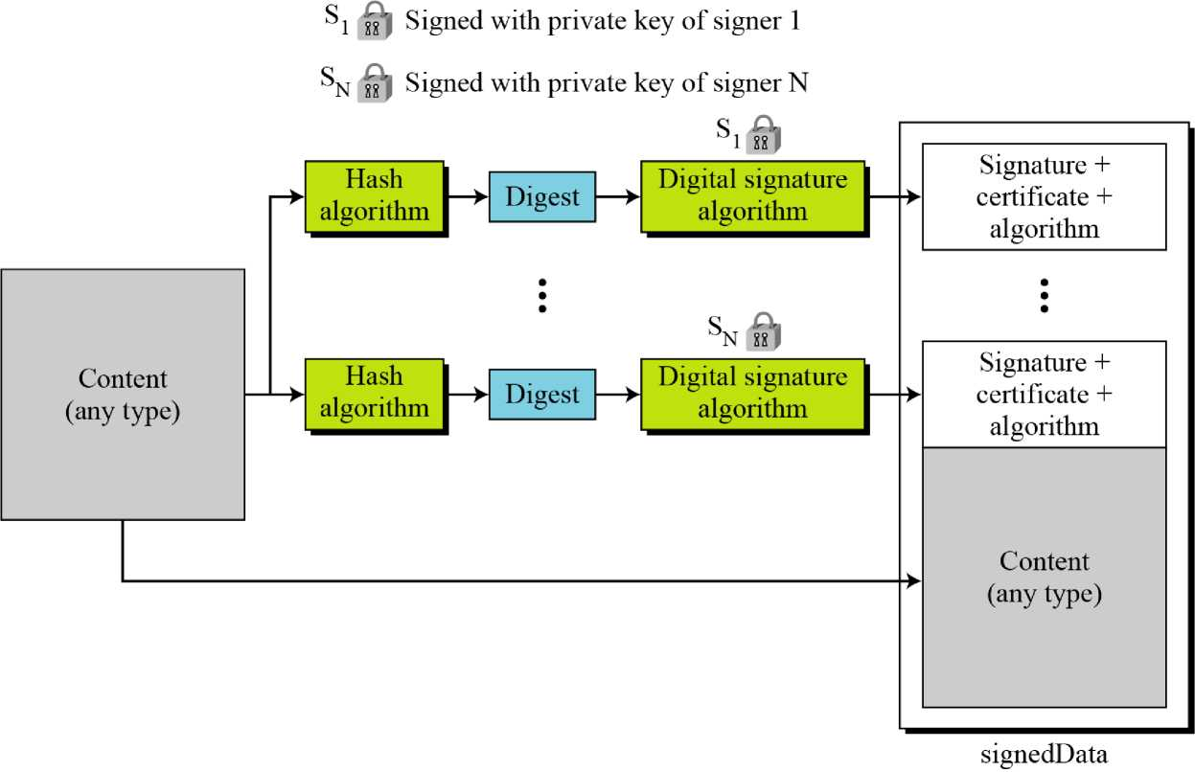
CRYPTOGRAPHY
16.3.2 Continued
Figure 16.27 Signed-data content type
BỘ MÔN ATTT – KHOA CNTT. Contact: huunoidq@gmail.com

Slide 56
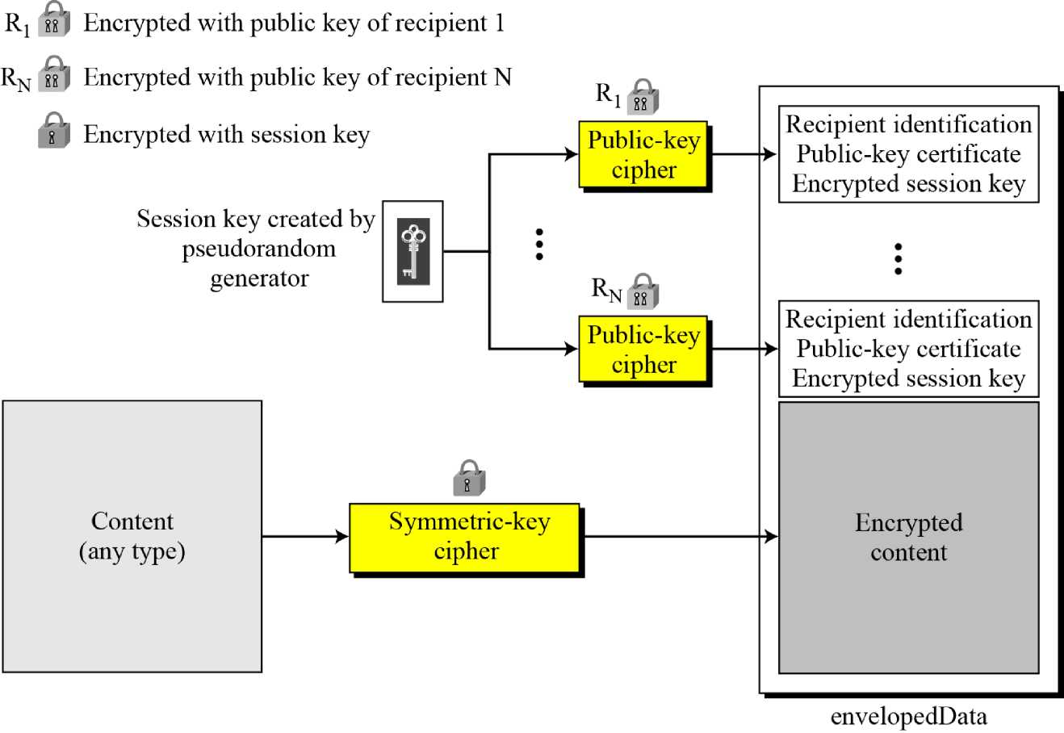
CRYPTOGRAPHY
16.3.2 Continued
Figure 16.28 Enveloped-data content type
BỘ MÔN ATTT – KHOA CNTT. Contact: huunoidq@gmail.com

Slide 57
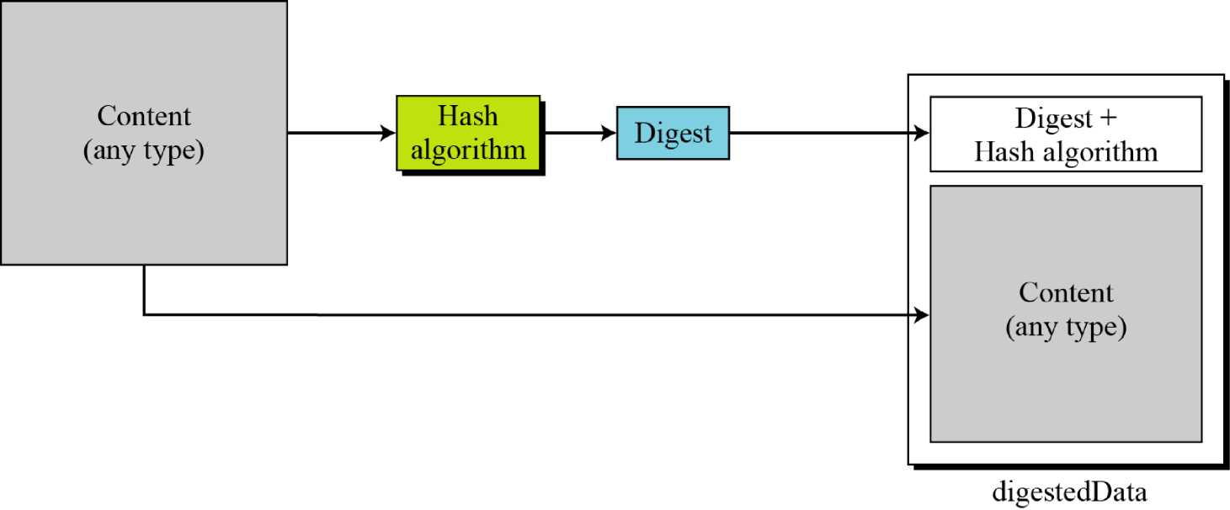
CRYPTOGRAPHY
16.3.2 Continued
Figure 16.29 Digest-data content type
BỘ MÔN ATTT – KHOA CNTT. Contact: huunoidq@gmail.com

Slide 58
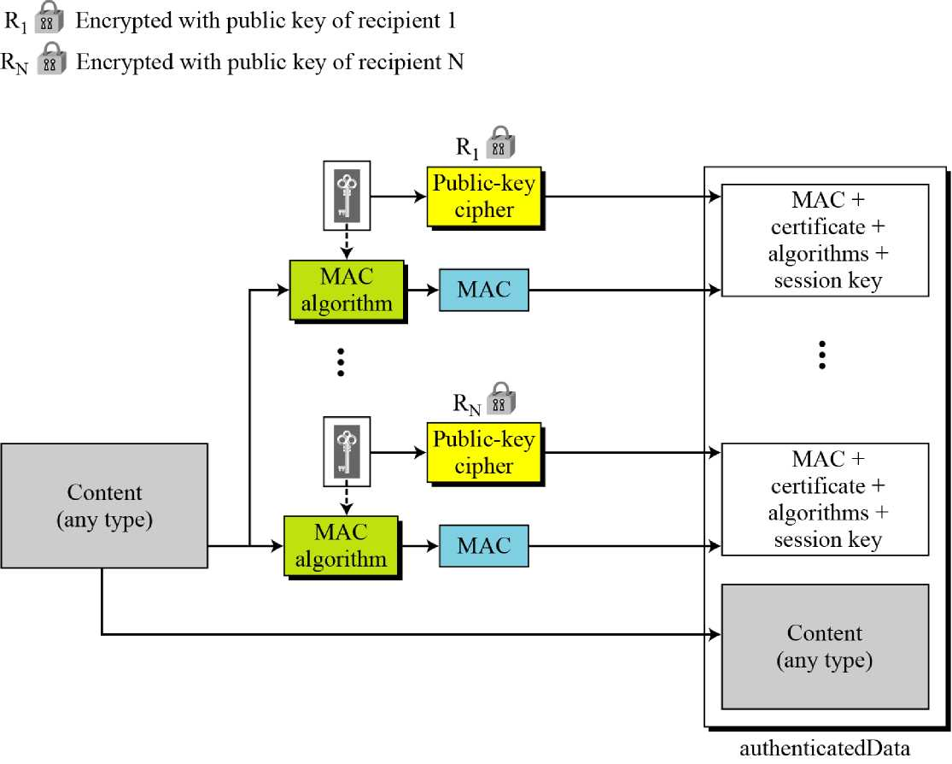
CRYPTOGRAPHY
16.3.2 Continued
Figure 16.30 Authenticated-data content type
BỘ MÔN ATTT – KHOA CNTT. Contact: huunoidq@gmail.com

Slide 59
CRYPTOGRAPHY
16.3.2 Continued
Cryptographic Algorithms
S/MIME defines several cryptographic algorithms. The term “must” means an absolute requirement; the term “should” means recommendation.
Table 16.17 Cryptographic algorithm for S/MIME
A Igorithm | Sender must support | Receiver must support | Sender should support | Receiver should support
Content-encryption algorithm | Triple DES | Triple DES |  | 1. AES 2. RC2/40
Session-key encryption algorithm | RSA | RSA | Diffie-Hellman | Diffie-Hellman
Hash algorithm | SHA-1 | SHA-1 |  | MD5
Digest-encryption algorithm | DSS | DSS | RSA | RSA
Message-authentication algorithm |  | HMAC with SHA-1
BỘ MÔN ATTT – KHOA CNTT. Contact: huunoidq@gmail.com

Slide 60
CRYPTOGRAPHY
16.3.2 Continued
Example 16.3
The following shows an example of an enveloped-data in which a small message is encrypted using triple DES.
Content-Type: application/pkcs7-mime; niinie-type=enveloped-data Content-Transfer-Encoding: Radix-64 Content-Description: attachment name=“report.txt”;
cb32ut67f4bhijHU21oi87eryb0287hmnklsgFDoY8bc659GhIGfH6543mhjkdsaH23YjBnmN ybmlkzjhgfdyhGe23Kjk34XiuD678Esl6se09jy76jHuytTMDcbnmlkjgfFdiuyu678543m0n3h G34un 12 P245 4Ho i 8 7e2 ry bOH2 Mj N 6 Ku y rl sg FDo Y 89 7fk923j ljk 1301 XiuD6gh78EsUyT23y
BỘ MÔN ATTT – KHOA CNTT. Contact: huunoidq@gmail.com

